Slide 1
Deepfake Image Classifier
Yuqing Cai

Slide 2
Approach
OpenCV, tensorflow
Facial Extraction
Convolutional Neural Network (CNN) Model
Label Prediction

Slide 3
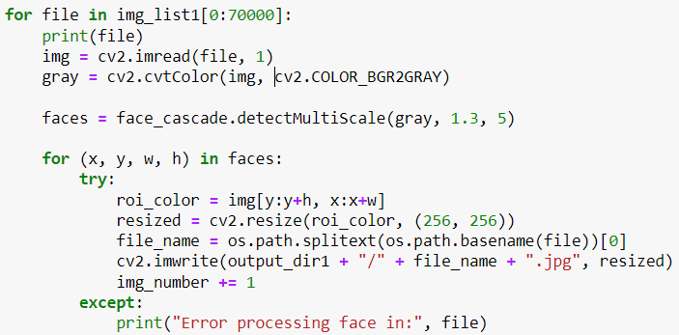
Image Processing and Extraction
Define file paths and create output directories for facial extraction
Iterates over the image files in the training, validation, and test directories
Reads and converts the image to grayscale
Detect faces using Harr Cascade classifier from OpenCV
Extract, resize faces to a fixed 256 * 256 size, save in output directory

Slide 4
Image Loading and Normalization
Extracted faces from training, validation, and test data are loaded from directories using “tf.keras.utils.image_dataset_from_directory”.
Automatically creates TensorFlow objects from images in directories.
Data is normalized by dividing pixel values by 255 to scale them to the range [0, 1]
Using “map” function on the dataset
Numerical Stability, Faster convergence, Consistency

Slide 5
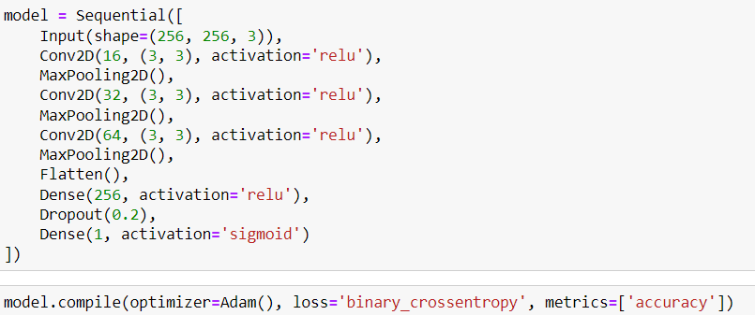
Model Definition/Compilation
CNN Model using tensorflow’s keras
Convolutional layers with max pooling
Dropout layer for regulation
Sigmoid activation for binary classification
compiled with the Adam optimizer and binary cross-entropy loss, accuracy as the evaluation metric

Slide 6
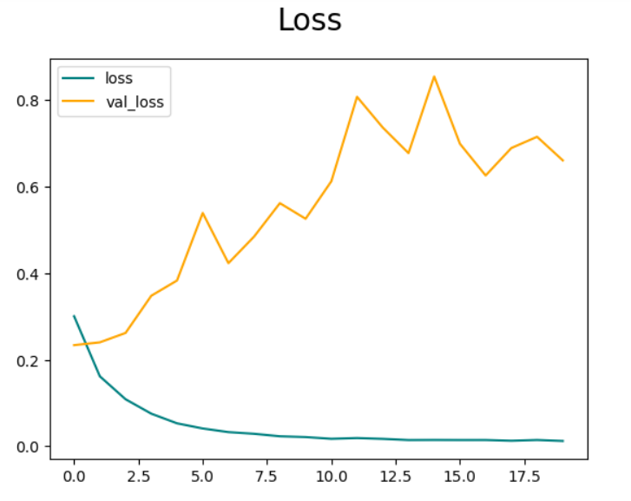
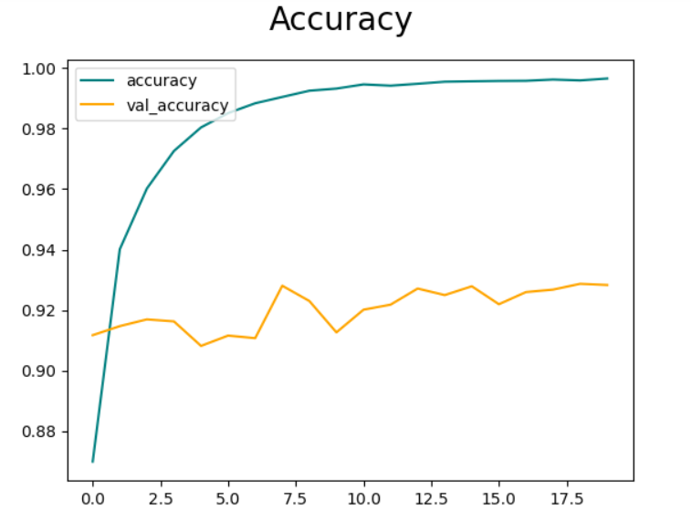
Training Visualization

Slide 7
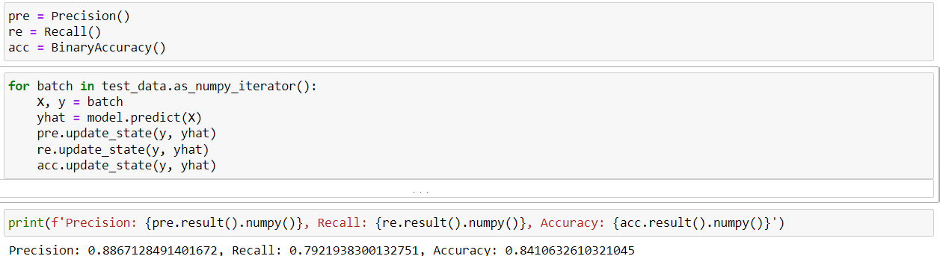
Performance Evaluation

Slide 8
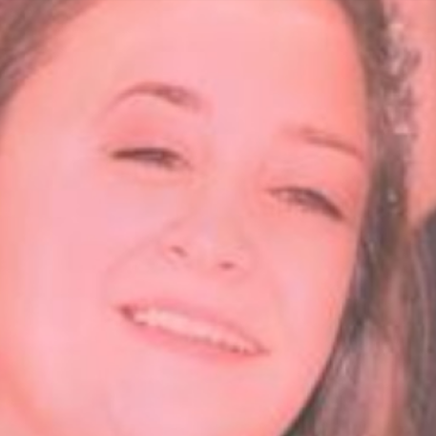
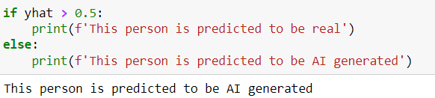
Labels Prediction
Prediction are made by applying a threshold of 0.5 to the model’s output
If yhat is greater than 0.5, it’s a real image
If yhat is less than 0.5, then it’s a deepfake image

Slide 9

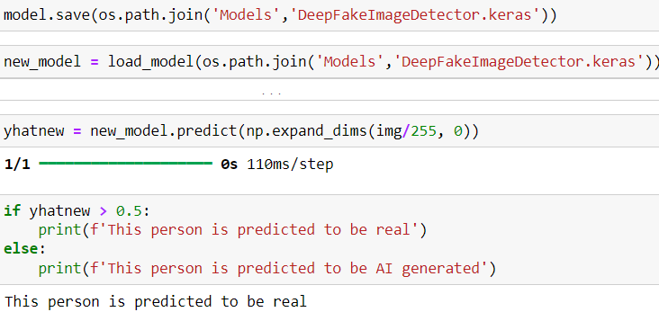
Re-Predicting Labels

Slide 10
Future Improvements
Implement data augmentation on dataset
Create 2 – 3 additional images from each existing image
Increase accuracy of the model

Slide 11
Questions?

